Slide 1

Progressive Mobile Application
PMA, an ever responsible mobile-app concept

Slide 2
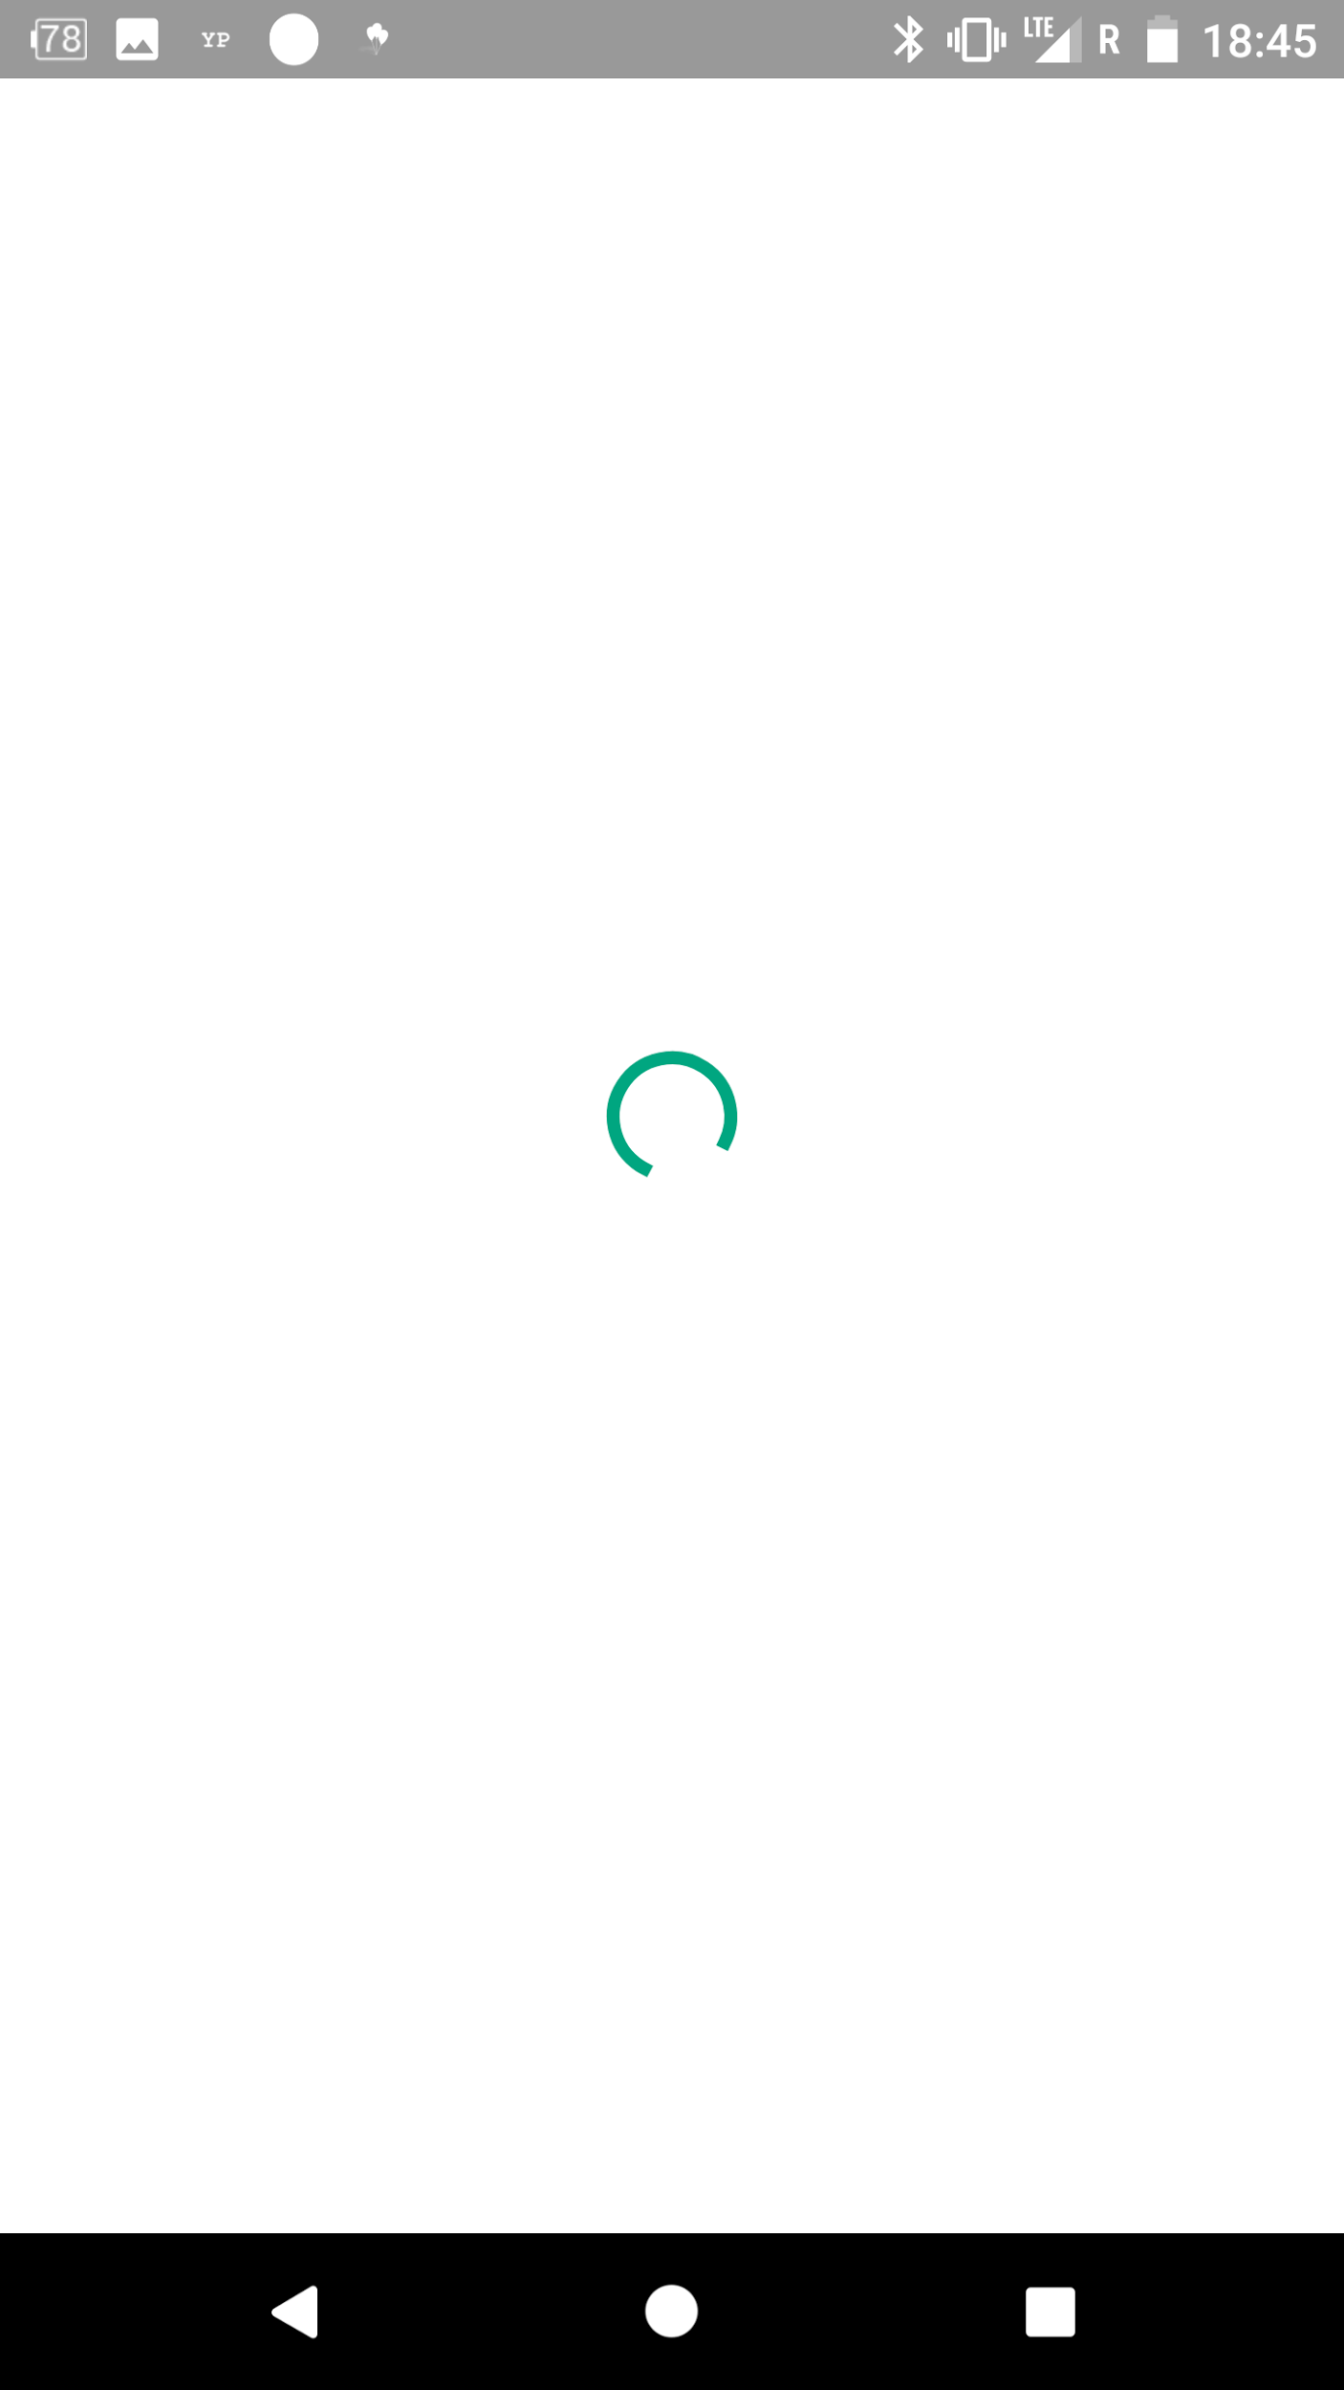
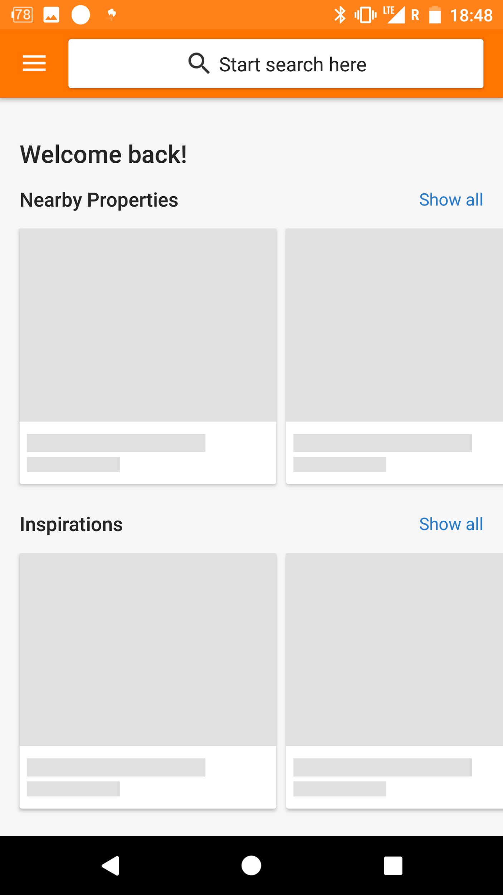
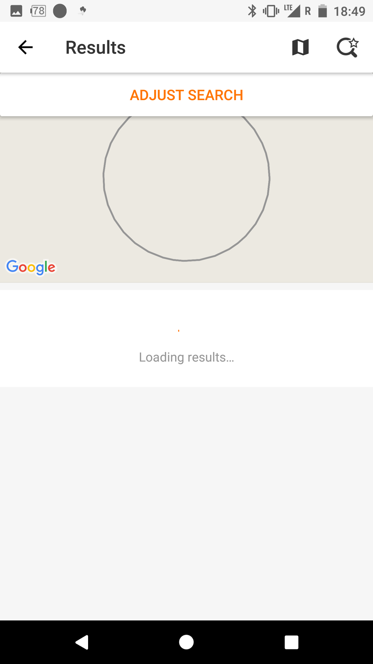


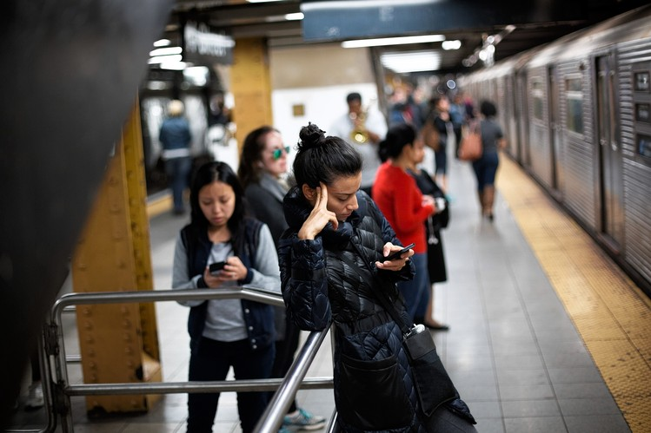
So sad, Bad UX without WiFi

Slide 3
Problems to general mobile-apps
App should provide information continuously, but not all.
App runs with network nicely, however…
In codes you see too many data-sources, different ways requesting data.
No solution for cases, i.e. offline, 3G~2G, airplane-mode etc.

Slide 4


What we need of our apps
stable, clear, correct handling, transparent circumstances, maintainable

Slide 5
Progressive App
Progressive Web App(PWA) ← Just great, I’m one of fans.
Reliable - Load instantly and never show the downasaur, even in uncertain network conditions.
Fast - Respond quickly to user interactions with silky smooth animations and no janky scrolling.
Engaging - Feel like a natural app on the device, with an immersive user experience.
Progressive Mobile App(PMA) ← Our topic

Slide 6
Foundation
Database on device
Data flow being Single & Unitary, either local-only or remote-only
Algorithm for select data
Network context sensitive
More payload on device
More chances for reload-data
Save all http-requests local, remove after reponses return or invalid(Just request)
Data
Network

Slide 7
Data
Local first or. Local only(select data)
Payload for every app-version
Encapsulate bizz-logical with local data(Single & Unitary)

Slide 8
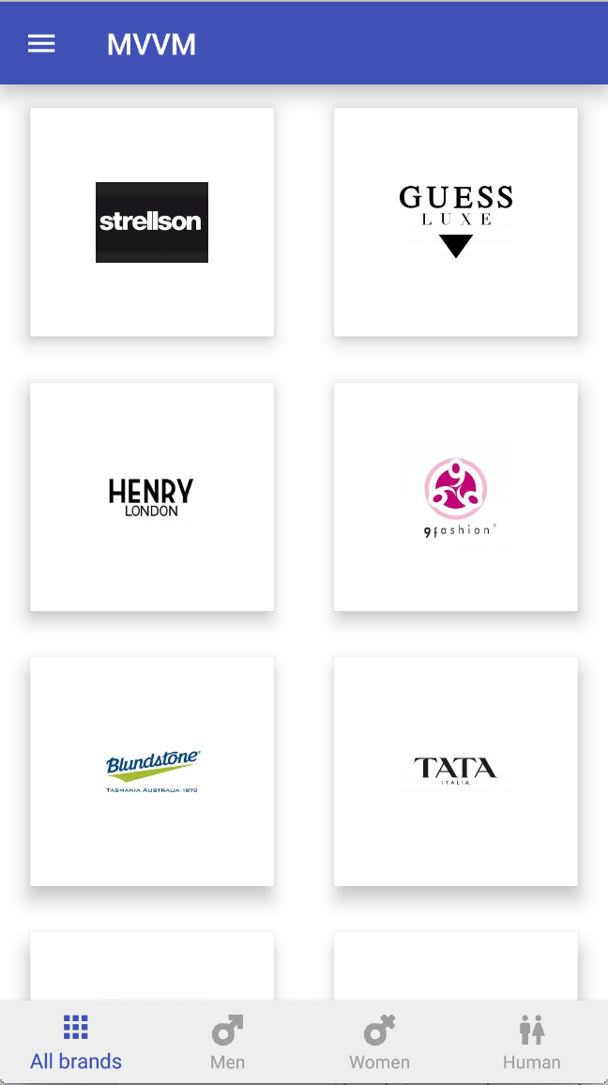
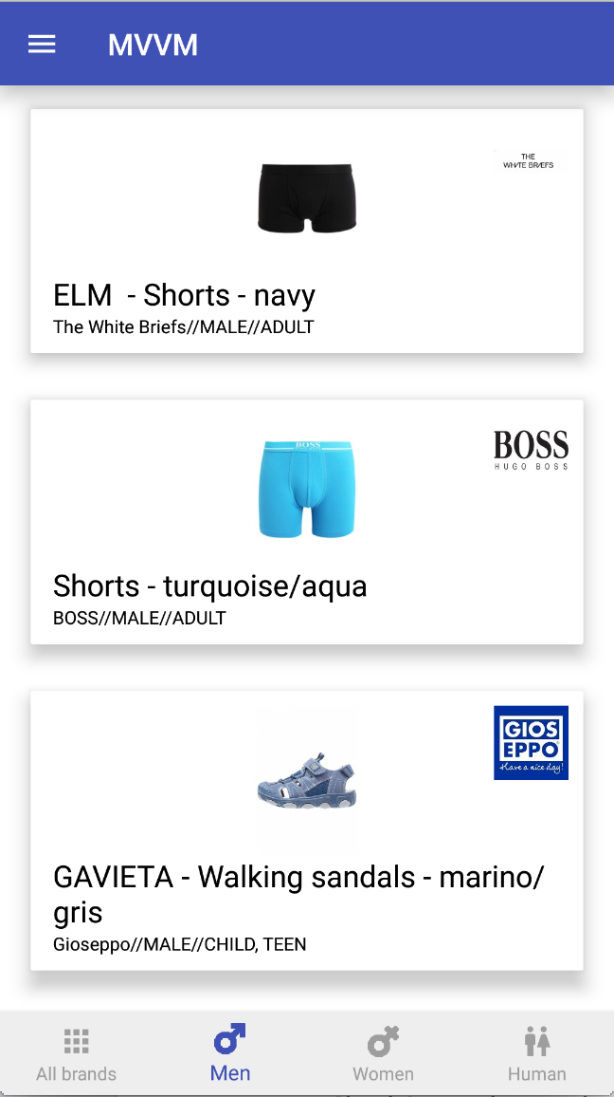

Cloud
App start, showing data from local or payload
Play with local data

Slide 9
Select data with AI
Inspired by Breadth-first search (BFS), top-bottom-left-right >= Lv3
select(x) := f(Local(), Empty-Case(), Error-handling(), Remote(), Cache(), File()... ...)
Neural Networks, deep learning
select(x) := f(Remote() + Local()+ Empty-Case() + Error-handling() + Cache() + File()... ...)

Slide 10
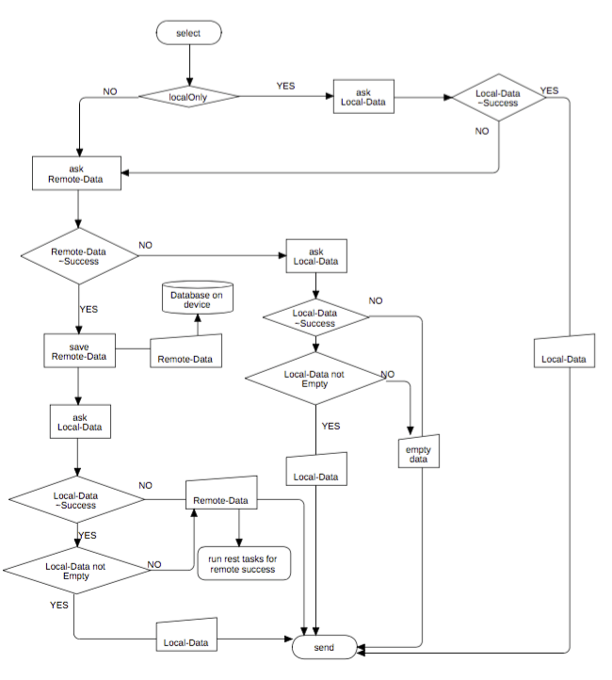
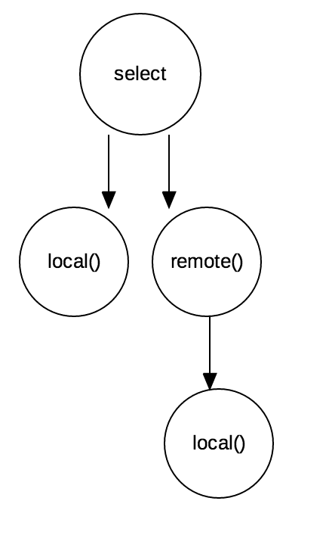
select(x) := f(Local(), Empty-Case(), Error-handling(), Remote())

Slide 11
Network
App knows changes of network-status.
App knows little different features for online and offline(inc. airplane).
App knows every http-request, ie. feeds update.
App knows error-cases and handle them with payload.
App knows how to reload data.
… ...

Slide 12
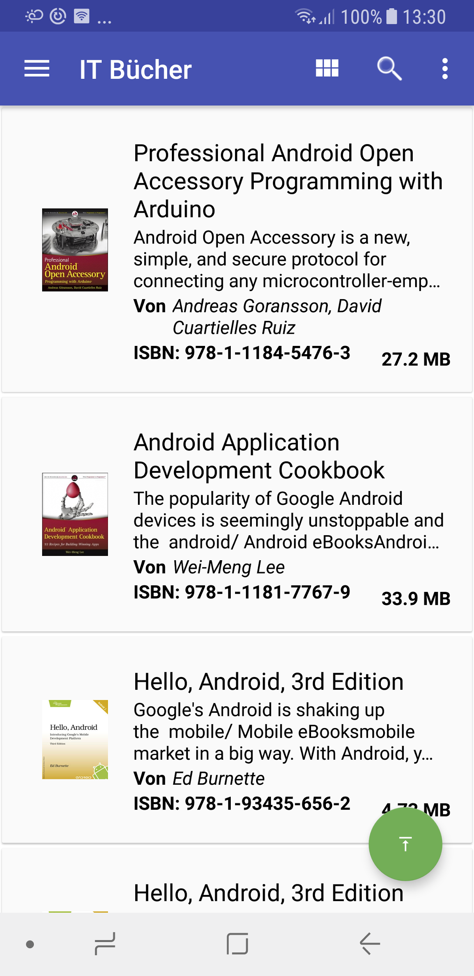
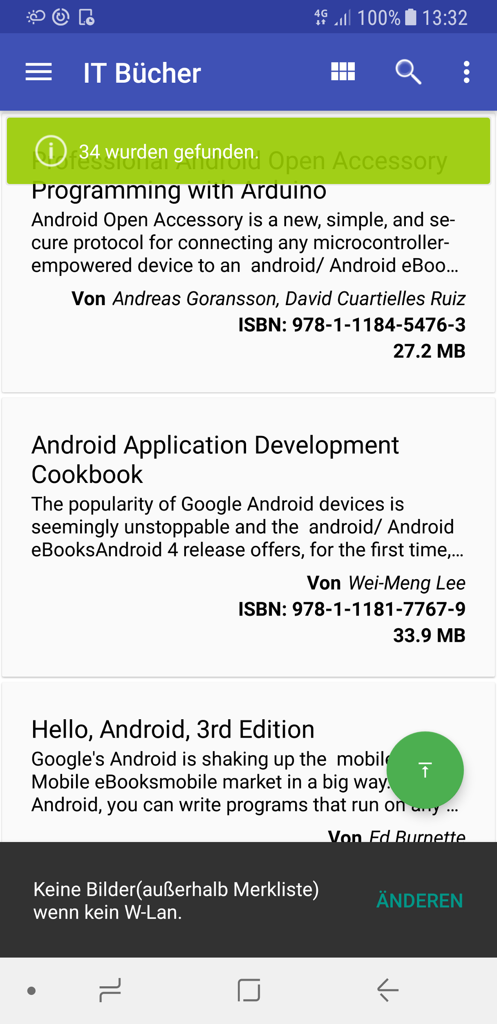
3G, 4G, H

Slide 13
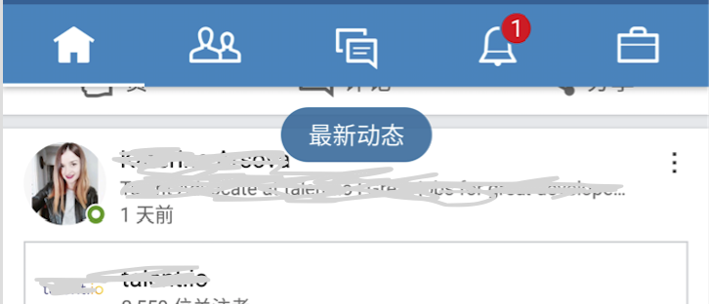
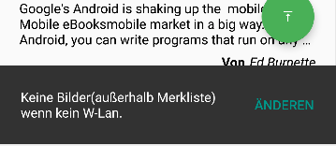
UX, avoid blocking, keep smooth
Refresh bubble
Notification
No Toast, less Dialog
More Snackbar(Android)
Update background and foreground showing local data(payload)

Slide 14
Checklist of PMA(prio+)
Avoid having Large area blank plus endless progress bar.
Avoiding showing empty-state or no-data messages.
....more chances to reload data....
....avoid a huge different between offline, online, airplane-mode ....
….Payload-Data....
….maintainable codes, readability first....

Slide 15
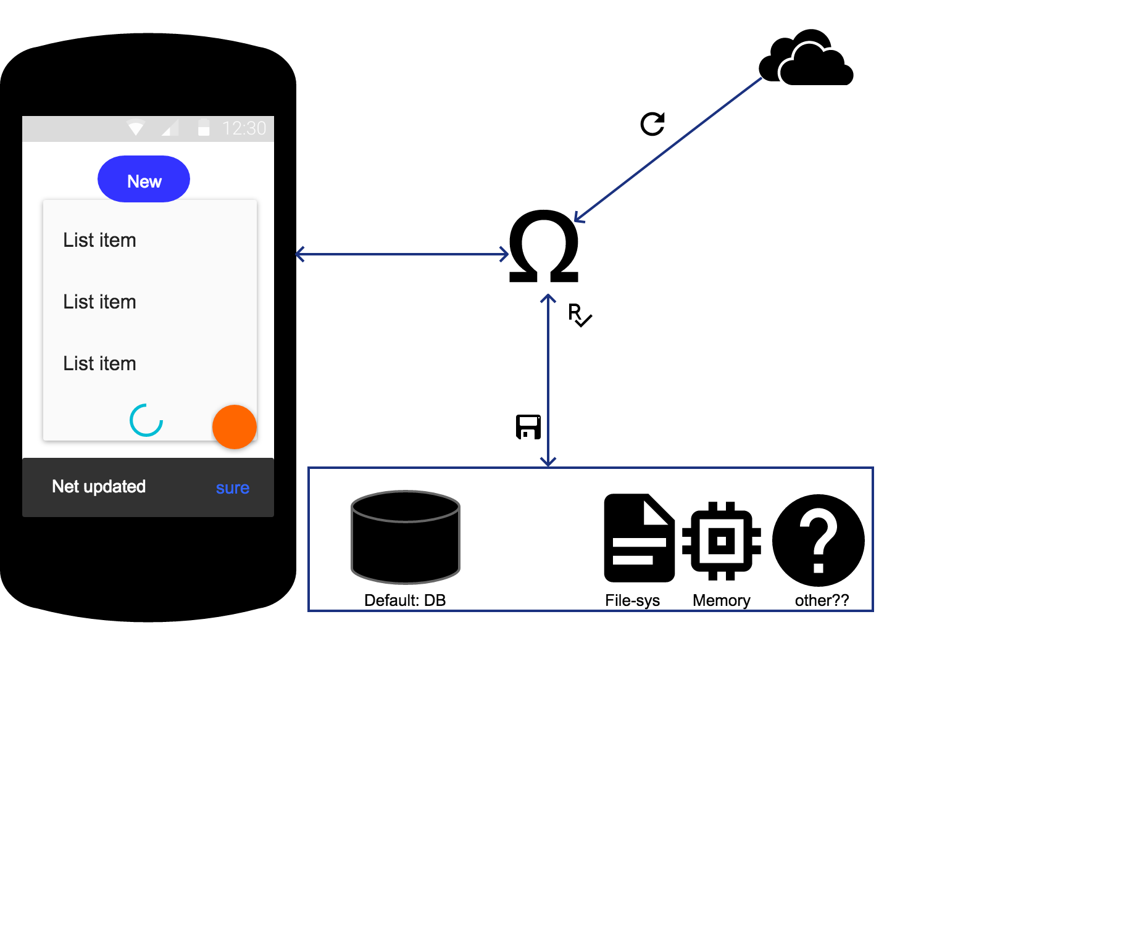

Slide 16
Who need PMA
No limit, some apps recommend:
News -- more underway, train, subway etc.
Fashion -- photos, medias, in shop, store
Instant-Message(IM) -- continuous
Social-Network(SN) -- underway & continuous

Slide 17
Final
“no empty, short loading”

Slide 18


Thanks
Home Page(paper’s working in progress + ppt): https://github.com/XinyueZ/pma
XinyueZ
@ChrisXYZhao

